Slide 1
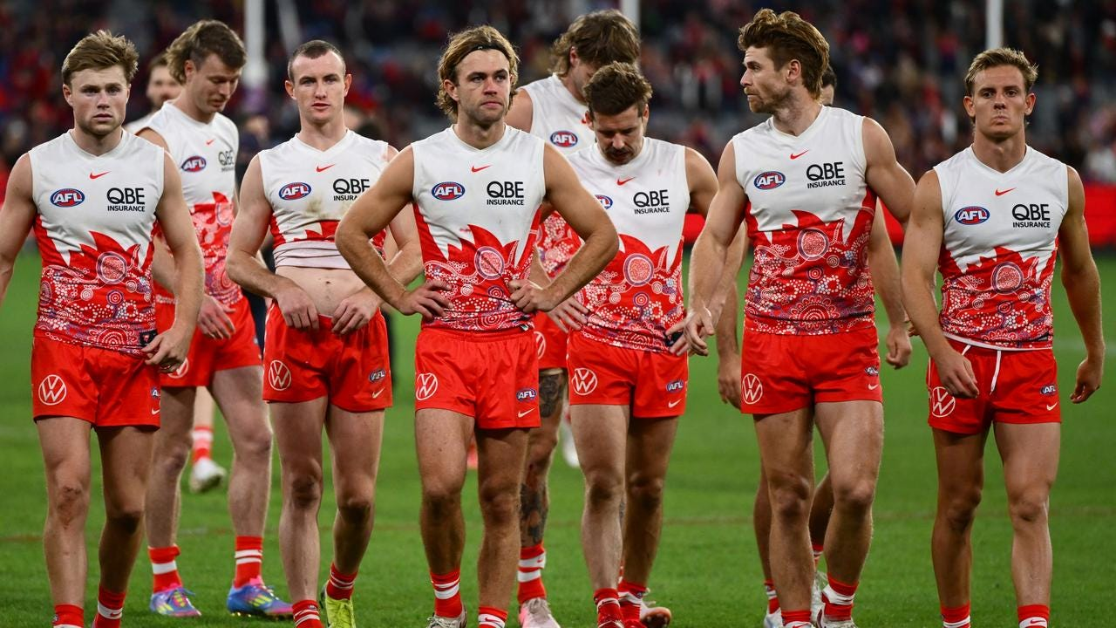
MGMT2094
Strategic Creativity and Innovation
Introduction
Dr John Edwards
Tutor
Semester Two 2026

Slide 2


Introduction
Dr John Edwards
E: john.edwards@mq.edu.au
au.linkedin.com/in/jcpedwards/
Notes:
2

Slide 3










My Work Background

Slide 4
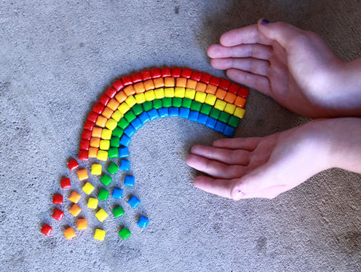
My Education/Teaching Background
Education
  Undergrad Commerce degree in Marketing (UNSW )
  MBA - eBusiness (UTS)
  MResearch (Macquarie)
  PhD (CSU)
  Teaching Background
  Lecturing Business & Management courses since 2004
  Corporate and Executive Education programs

Slide 5
Introductions
Name
What part of the world/city/town you come from ?
Something interesting about you / Hobbies ??
Favourite Mobile App ??

Slide 6
Assessment Tasks
Creative Project (Ind) (40%) Weeks 4 and 6.
2. Group Innovation Project (30%) Weeks 11
Written Task (30%) Exam Period.

Slide 7
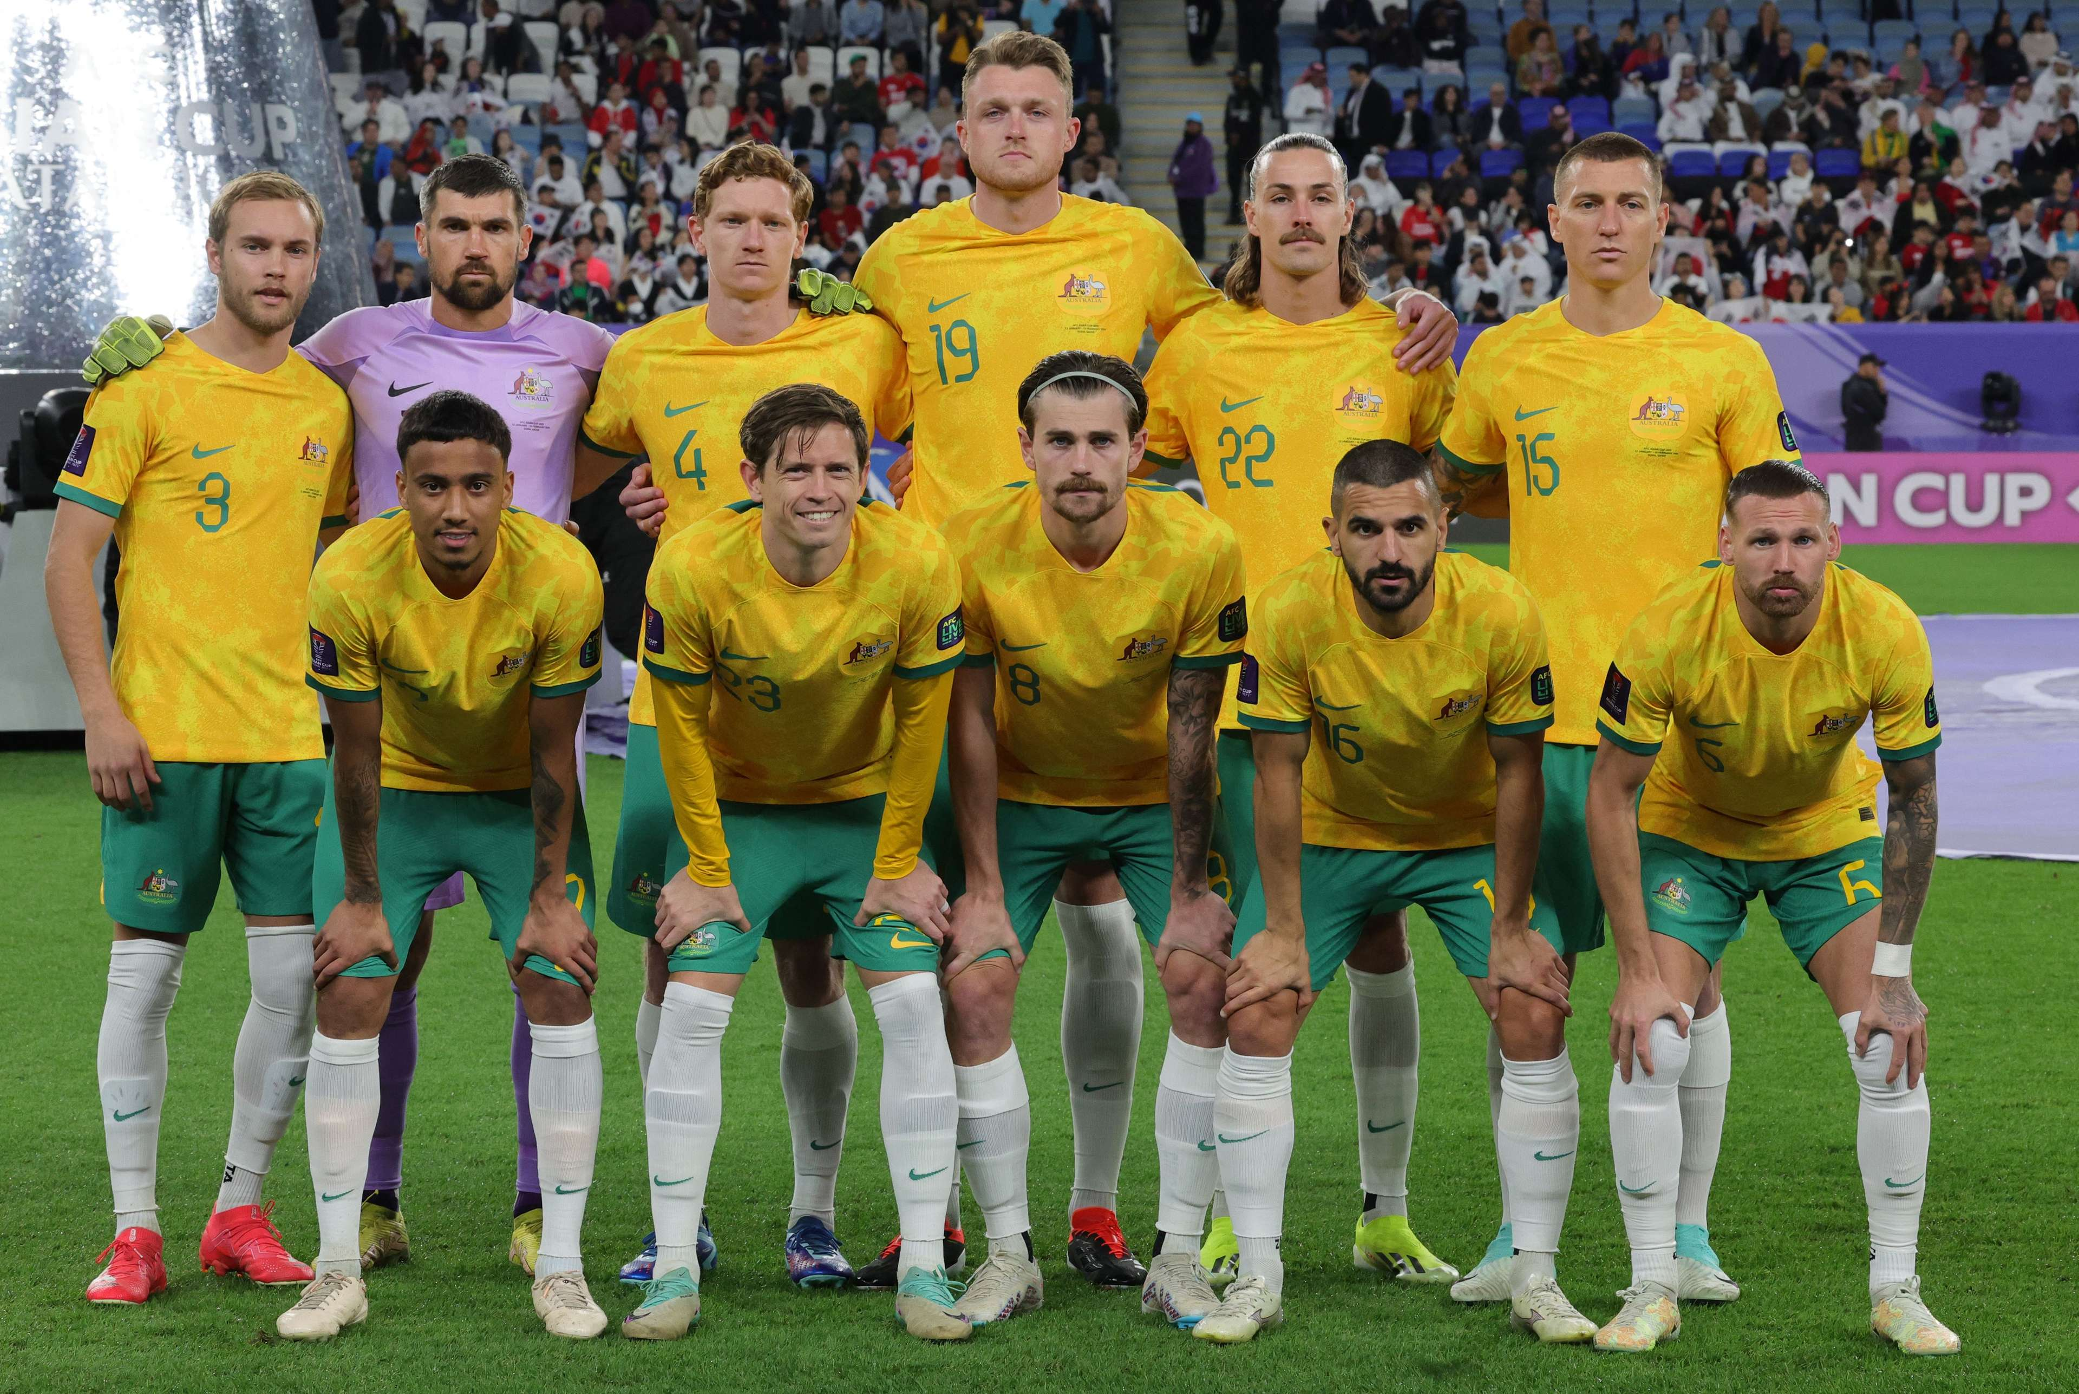
1. Creative Project (40%)
Assessment 1 - Creative Project
Weight: 40%
Due date: Week 4 and Weeks 6.
Individual Project
Part A: Mind Map – Week 4 (10%). Exploring ideas
Part B: Video / Poster – Week 6 (30%). Solutions.
Refer to iLearn / Assessments.

Slide 8

2. Group Innovation Project (30%)
Weight: 30%
Due Date: Weeks 11
The film/video presentation will be a creative production that depicts innovative solutions and how you are preparing to lead the change in respect to your solution to the issue.
Form groups in Week 4.
Refer to iLearn / Assessments.

Slide 9
3. Written Task (30%)
Weight: 30%
Due date: Exam Period.
Task Overview:
Assessment 3 is a final exam designed to assess your understanding of key creativity and innovation concepts covered across the unit. The exam emphasizes application: you will answer questions that require you to explain, compare, and apply innovation approaches in organisational contexts.
Refer to iLearn / Assessments.

Slide 10


Slide 11


